Slide 1
NV Log Design
Naveen Ramaswamy
15-July-2021
Notes:
1

Slide 2
PROBLEM STATEMENT
Byte-wise erasable media (EEPROM) are expensive and are typically not embedded within microcontrollers.
Flash which is block-wise erasable is cheaper, but the implementation complexity is higher.
The goal is to design a NV Log module which stores and efficiently maintains log within a Flash.
The inputs to this module are log size, block size, number of blocks, pointer to data to read to/write from and length of the data.
The status of the NV log is returned as output.

Slide 3
DEFINITION OF THE NV LOG PARAMETERS
Log Size - Size of each log entry.
Entry Size - Size of the log with its metadata (CRC) appended to it.
Block Size - Size of each block in the flash.
Number of Blocks – Number of blocks in the flash to use.
Block Start Address – Address within the flash from where the logging is supposed to start.
Read Pointer (RP) – Pointer to the location of the start of the oldest log in the flash.

Slide 4
Write Pointer (WP) – Pointer to the location where the next log has to be written in the flash.
Entries Per Block – Number of log entries (log data + metadata) that can be fully fit in a block without spilling over to the next block.
Log Count (LC) – The number of logs present in NV Log.
Log Index - A number in [0, LC). This is expected to be used by the user of NV Log to read logs.
Block Revision Number (BRN) - Represents number of blocks erased since start of logging.

Slide 5
NV LOG Algorithms
Initialization
Reading a Request
Writing an Entry
Reading an Entry
Updating the WP
Corner cases
Write Block Exhausted
Roll-over
Corrupt BRN
Corrupt Log
Log Not Available

Slide 6
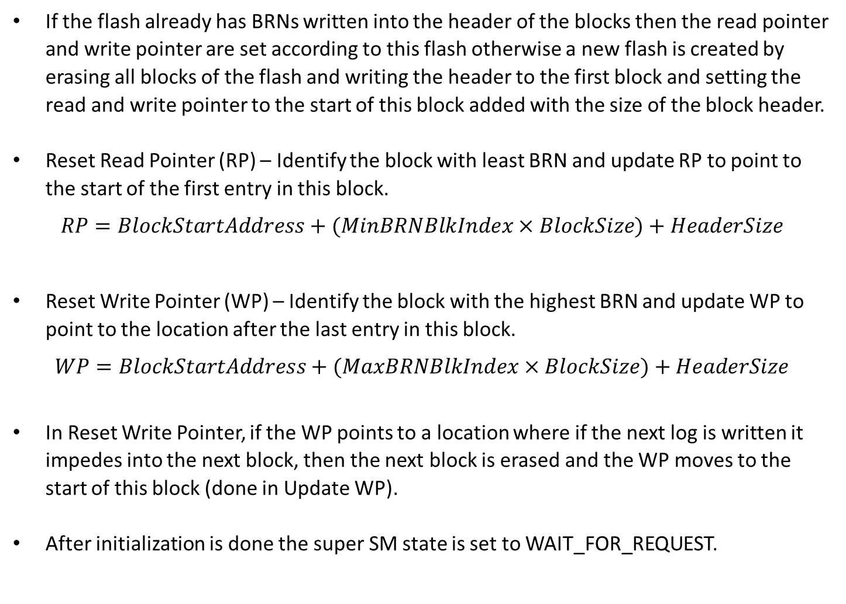
INITIALIZATION
If the flash already has BRNs written into the header of the blocks then the read pointer and write pointer are set according to this flash otherwise a new flash is created by erasing all blocks of the flash and writing the header to the first block and setting the read and write pointer to the start of this block added with the size of the block header.
Reset Read Pointer (RP) – Identify the block with least BRN and update RP to point to the start of the first entry in this block.
$$RP=BlockStartAddress+(MinBRNBlkIndex×BlockSize)+HeaderSize$$
Reset Write Pointer (WP) – Identify the block with the highest BRN and update WP to point to the location after the last entry in this block.
$$WP=BlockStartAddress+(MaxBRNBlkIndex×BlockSize)+HeaderSize$$
In Reset Write Pointer, if the WP points to a location where if the next log is written it impedes into the next block, then the next block is erased and the WP moves to the start of this block (done in Update WP).
After initialization is done the super SM state is set to WAIT_FOR_REQUEST.

Slide 7
Initialization
Start
Is BRN available?
Erase Flash
No
Yes
Write header of first block
Calculate and set RP
New Flash Init
Set RP to first block
Calculate and set WP
Is WP impeding onto next block?
Set WP to first block
Yes
Erase next block
No
End
Set WP to next block

Slide 8
Initialization of a new flash in the case of flash being empty
Space filled with log
Space empty
Space with header
Block Header
No BRN
No BRN
No BRN
No BRN
BRN
Block 1
Block 2
Block 3
Block 4
CRC
New Flash Initialization
Block header
Space filled with log
Space empty
Space with header
BRN 0
No BRN
No BRN
No BRN
Write Pointer
Read Pointer
Block 1
Block 2
Block 3
Block 4

Slide 9
Initialization of a flash with already existing entries
Space filled with log
Space empty
Space with header
Block header
BRN 0
BRN 1
BRN 2
BRN 3
Read Pointer
Write Pointer
Block 1
Block 2
Block 3
Block 4
If the flash already has block headers and entries written into it, then this information is used to formulate the position of the WP and the RP of the flash.

Slide 10
READING A REQUEST
Check if the request queue is empty or not.
If the queue is not empty check if the first element in the queue is a read or write request.
If the request is a read request, then switch the super SM state to READ_LOG.
If the request is a read request, then switch the super SM state to WRITE_LOG.
WRITING A ENTRY
First calculate the CRC of the log and then append it to the log to be written.
Write the log in the location pointed to by the write pointer.
Update the write pointer.

Slide 11
Writing a Log Entry
Start
Calculate CRC of log to be written and append it to the block
Write the entry to the location pointed to by WP
Add entry size to the WP
Is WP impeding onto next block?
Yes
Erase next block
No
End
Set WP to next block

Slide 12
Variation of the WP and filling if flash on writing an entry
Space filled with log
Space empty
Space with header
BRN 0
BRN 1
BRN 2
BRN 3
When an entry is written into the flash, the log is written into the position currently pointed to by the WP and then the WP is updated to point to the location after the log.
Read Pointer
Write Pointer
Block 1
Block 2
Block 3
Block 4
Writing an entry
Space filled with log
Space empty
Space with header
BRN 0
BRN 1
BRN 2
BRN 3
Read Pointer
Write Pointer
Block 1
Block 2
Block 3
Block 4

Slide 13
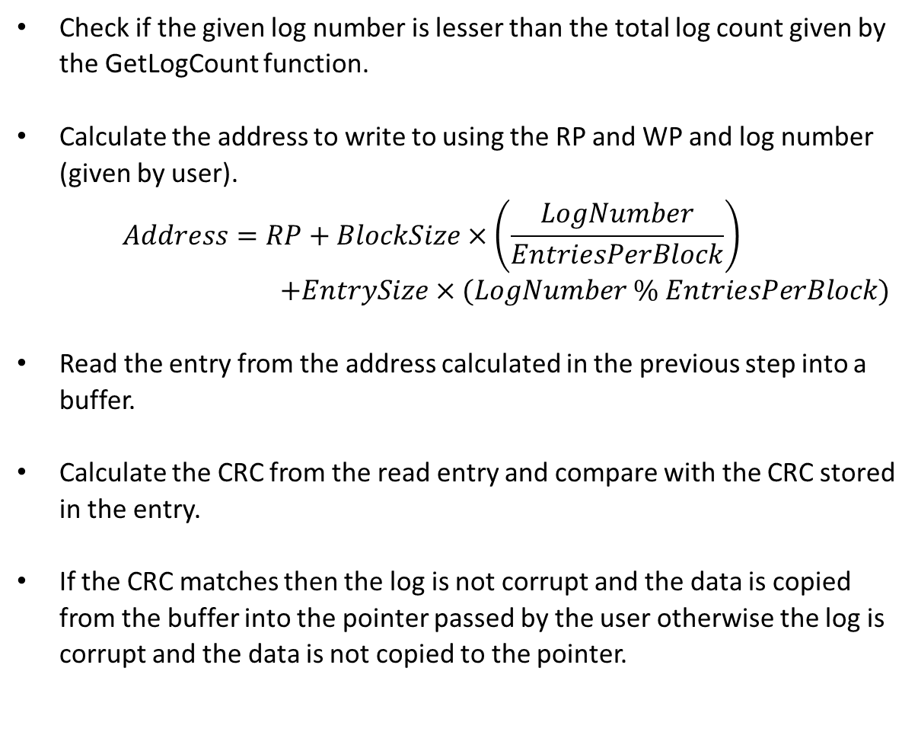
READING AN ENTRY
Check if the given log number is lesser than the total log count given by the GetLogCount function.
Calculate the address to write to using the RP and WP and log number (given by user).
$$Address=RP+BlockSize×\left(\frac{LogNumber}{EntriesPerBlock}\right)$$
$+EntrySize×(LogNumber \% EntriesPerBlock)$
Read the entry from the address calculated in the previous step into a buffer.
Calculate the CRC from the read entry and compare with the CRC stored in the entry.
If the CRC matches then the log is not corrupt and the data is copied from the buffer into the pointer passed by the user otherwise the log is corrupt and the data is not copied to the pointer.

Slide 14
Reading a Log Entry
Start
Calculate the address to start reading from the flash using RP and log number
Read the entry from the location pointed to by this address into a temporary array
Compute CRC of this entry and compare with stored CRC
Do the CRCs match?
Copy the entry from the temporary array to the pointer passed by the user
Yes
No
End

Slide 15
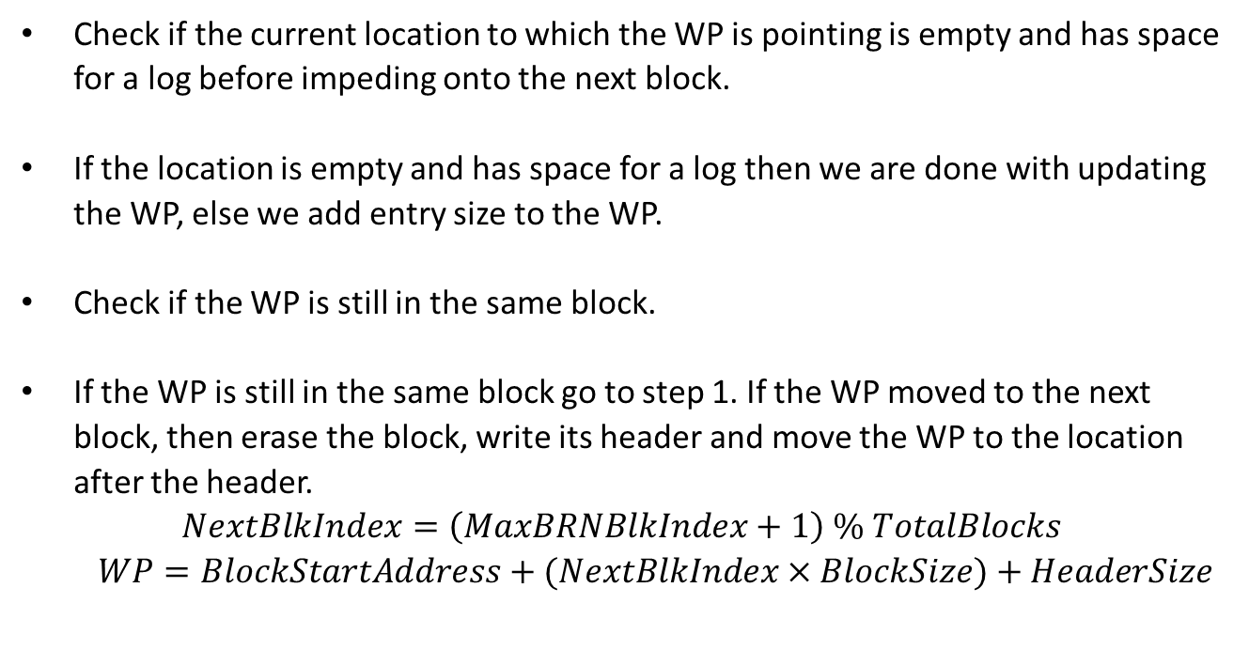
UPDATING THE WP
Check if the current location to which the WP is pointing is empty and has space for a log before impeding onto the next block.
If the location is empty and has space for a log then we are done with updating the WP, else we add entry size to the WP.
Check if the WP is still in the same block.
If the WP is still in the same block go to step 1. If the WP moved to the next block, then erase the block, write its header and move the WP to the location after the header.
$$NextBlkIndex=\left(MaxBRNBlkIndex+1\right) \% TotalBlocks$$
$$WP=BlockStartAddress+(NextBlkIndex×BlockSize)+HeaderSize$$

Slide 16
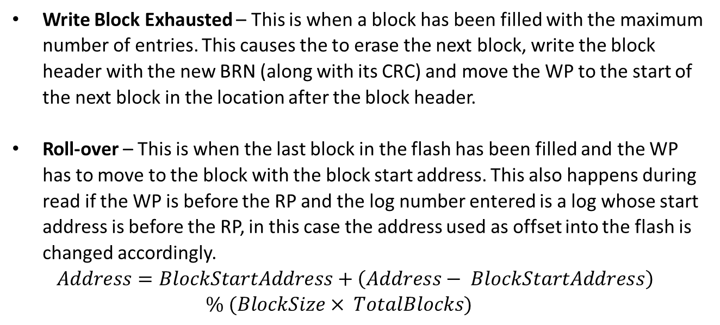
CORNER CASES
Write Block Exhausted – This is when a block has been filled with the maximum number of entries. This causes the to erase the next block, write the block header with the new BRN (along with its CRC) and move the WP to the start of the next block in the location after the block header.
Roll-over – This is when the last block in the flash has been filled and the WP has to move to the block with the block start address. This also happens during read if the WP is before the RP and the log number entered is a log whose start address is before the RP, in this case the address used as offset into the flash is changed accordingly.
$$Address=BlockStartAddress+\left(Address− BlockStartAddress\right)$$
$$\% (BlockSize× TotalBlocks)$$

Slide 17
WP, RP and Flash status after Roll-Over
Space filled with log
Space empty
Space with header
When the WP reaches the end of the last block then the first block is erased and the WP is moved to the start of the erased block after its block header has been written.
BRN 0
BRN 1
BRN 2
BRN 3
Read Pointer
Write Pointer
Block 1
Block 2
Block 3
Block 4
Roll – Over (Also a case of Write Blk Exhausted)
Read Pointer
Space filled with log
Space empty
Space with header
BRN 4
BRN 1
BRN 2
BRN 3
Write Pointer
Block 1
Block 2
Block 3
Block 4

Slide 18
Corrupt BRN – This is when the CRC of the stored BRN is calculated and it does not match the CRC of the block header that is stored with the BRN, in this situation the block corrupt status is returned and the block header is not taken.
Corrupt Log – This is when the stored log is read and the CRC calculated after retrieving it does not match the stored CRC for the log, in this situation the log corrupt status is returned and the log data is not returned to the user.
Log Not Available – This is when the log number entered by the user exceeds the number of logs that currently exist in the flash. This returns the log not available status and does not return the data.

Slide 19
EXAMPLE IMPLEMENTATION
These are parameters of an sample flash.
Calculated parameters
An excel tool to do these calculations has been created.
Parameters | Size
Flash memory size | 5120 bytes
Block size (minimum erasable unit) | 256 bytes
Block metadata size | 8 bytes
Log Size | 20 bytes
Log metadata size | 4 bytes
Parameters | Calculation formula | Size
Number of blocks | Flash memory size /Block size | 20 blocks
Actual size per entry | Log Size + Log metadata size | 24 bytes
Available block size (usable by blocks) | Block size - Block metadata size | 248 bytes
Logs per block | Block size // Actual size per entry | 10 logs
Max total logs | Logs per block * Number of blocks | 200 logs
Min total logs (once flash has been filled) | Max total logs - Logs per block | 190 logs

Slide 20
DESIGN
The module is designed to model a state machine implementation.
There is one super state machine, the update function called in the super loop runs through one iteration of this state machine.
Within this super SM other state machines are present.
The state machines in this implementation are:
Super State Machine.
Initialize Write State Machine.
Write Block Header State Machine.
Read Flash, Erase Flash and Write Flash State Machines.

Slide 21
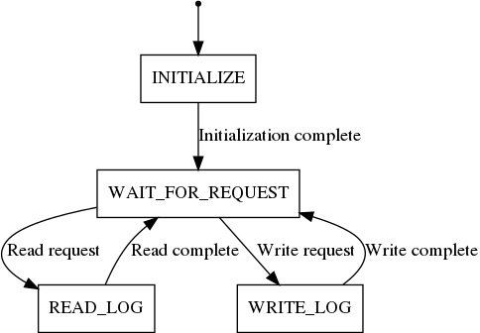
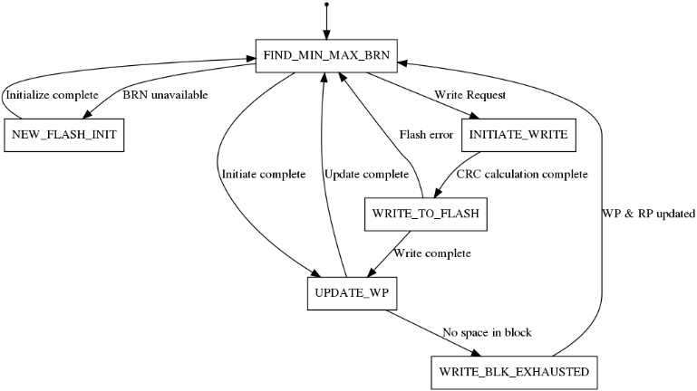
STATE MACHINES
Super SM states
INITIALIZE
WAIT_FOR_REQUEST
READ_LOG
WRITE_LOG
Initialize Write SM States
FIND_MIN_MAX_BRN
NEW_FLASH_INIT
INTIATE_WRITE
WRITE_TO_FLASH
UPDATE_WP
WRITE_BLK_EXHAUSTED

Slide 22
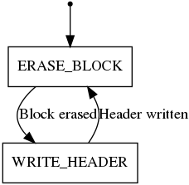
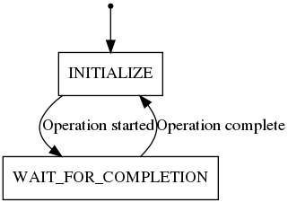
STATE MACHINES
Write Block Header SM States
ERASE_BLOCK
WRITE_HEADER
SM States of Read Flash, Erase Flash and Write Flash
INITIATE_REQUEST
WAIT_FOR_COMPLETION

Slide 23
SOFTWARE WORK FLOW
NO
Software Development
Develop Unit tests in desktop
PASS
YES
PASS
YES
Test in target
DONE
NO
All algorithms for maintaining of the log in NV LOG were implemented and unit tested in a desktop environment.
The tests primarily create a flash object and pass that as an input to NV_LOG.
NV_LOG dependencies (ex: FLASH, json) were mocked.

Slide 24
MODULE HIERARCHY
The NV Log module does not directly access the flash but instead accesses it through the NV Log Interface. The NV Log Interface is set to access the mock flash in the desktop environment for testing and accesses the actual flash when run in the target environment.
NV Log
NV Log Interface
Flash driver
Mock driver

Slide 25
UNIT TESTS
Classes were created for each test case.
Each test class has an instance of the interface and mock flash.
The mock flash stores the data onto a json file using a C++ json library.
The interface provides functions to NV Log to access the flash.
The test classes have a run function and description function.
The run function runs the test.
The description function tells us the functionality which is being tested in the form of a string.
The test class instances are stored in a test suite.
The tests are compiled using a makefile when the make command is run.
The make run command runs all the tests in the test suite.

Slide 26
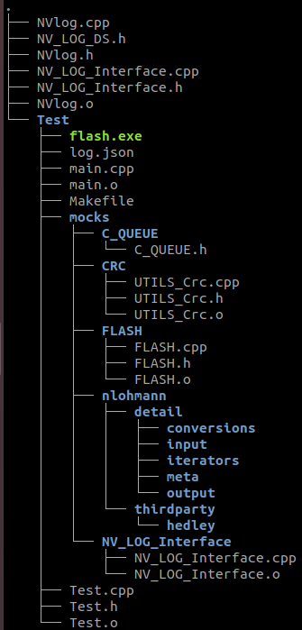
DIRECTORY STRUCTURE
NV_LOG – Contains the implementation of the NV_LOG and its sub-modules.
Tests – Contains implementation of tests.
mocks – Contains mocks of NV_LOG dependencies.

Slide 27
DIRECTORY STRUCTURE
C_QUEUE – Contains implementation of circular queue used by NV_LOG. Used for request queue computation.
CRC – Contains the functions needed for the calculation of the CRCs.
FLASH – Contains implementation of the mock flash used for testing in the desktop environment.
nlohmann – Contains the functions to convert the data in the flash into a json format for storing in a file.

Slide 28
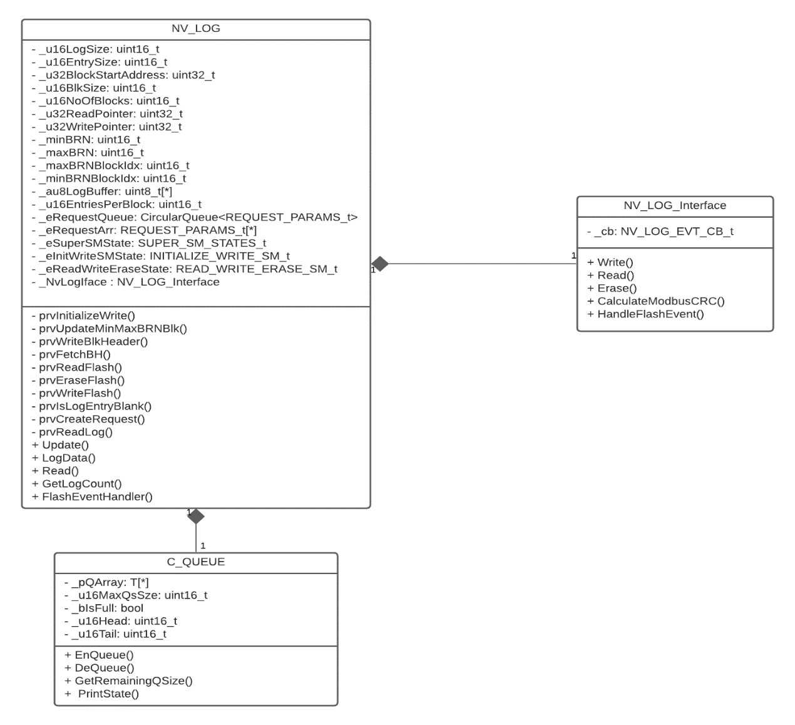
CLASS ORGANIZATION
NV_LOG class uses algorithms to decide how to maintain the logs within the flash.
NV_LOG_Interface class is used by NV_LOG to access the functions of the flash.
C_QUEUE class is a circular queue used to enqueue read and write requests and dequeue them once they have been served/completed.

Slide 29
DOCUMENTATION
Code Level Documentation – The code is sufficiently commented and also complies with the Sedemac coding guidelines.
Software Design Document – A detailed document has been created.
An excel based tool to derive NV Log parameters based on block media parameters.
HOW TO RUN TESTS
The test code is compiled, and an executable is created using a Makefile where all the source files and their directories are included and used to make the object files.
Make clean – Cleans up the old object files and removes the executable.
2. Make – Creates the dependencies (object files) according to the rules and make files and creates the executable.
3. Make run – Runs the created executable

Slide 30
END OF PRESENTATION
Notes:
30

